Slide 1
2020-07-21 Presentation
Salih Fırat Canpolat

Slide 2
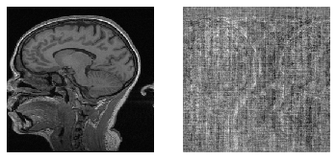
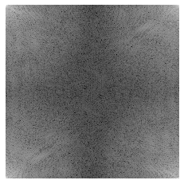
The Dataset
Single channel data from Multi-channel MR Image Reconstruction Challenge (MC-MRRec) is used.
25 training, 10 validation cases with 170, 256, 256, 2 shape (sampe, hy, hx, complex)
Magnitude
Phase
K-Space

Slide 3
Undersampling
Cartesian sampling with 1 sample on center, 4 times acceleration, with no centering was used, 10 lines at the borders were used.
Data loader fed the model with the mask uniquely generated for each sample and each epoch.
Undersampling was done within the model except for magnitude input.

Slide 4
Models
MSE
V4 MSE
3x MSE
PSNR
CCE
IGL
MAE
SSIM

Slide 5
Progess in Non-Immediate Goals
Worked on fastMRI data pipeline.
Worked on a faster data pipeline that prepares batches in parralel.
Worked on tied weights for CNNs.
Researched the workings of VANs and GANs.

Slide 6
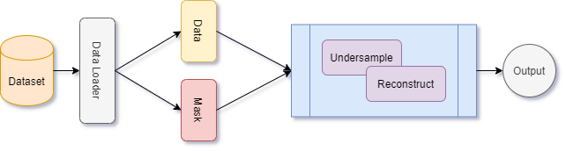
Reconstruction Operation Overview

Slide 7
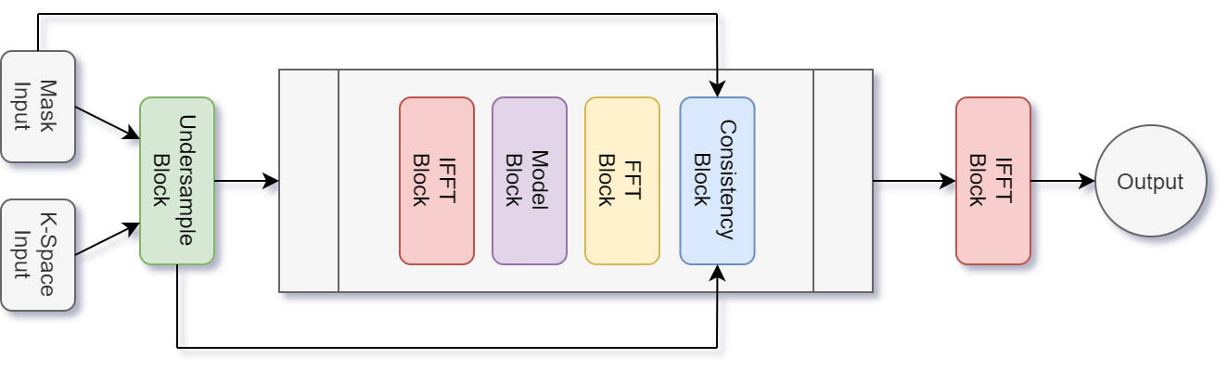
Architecture Overview

Slide 8
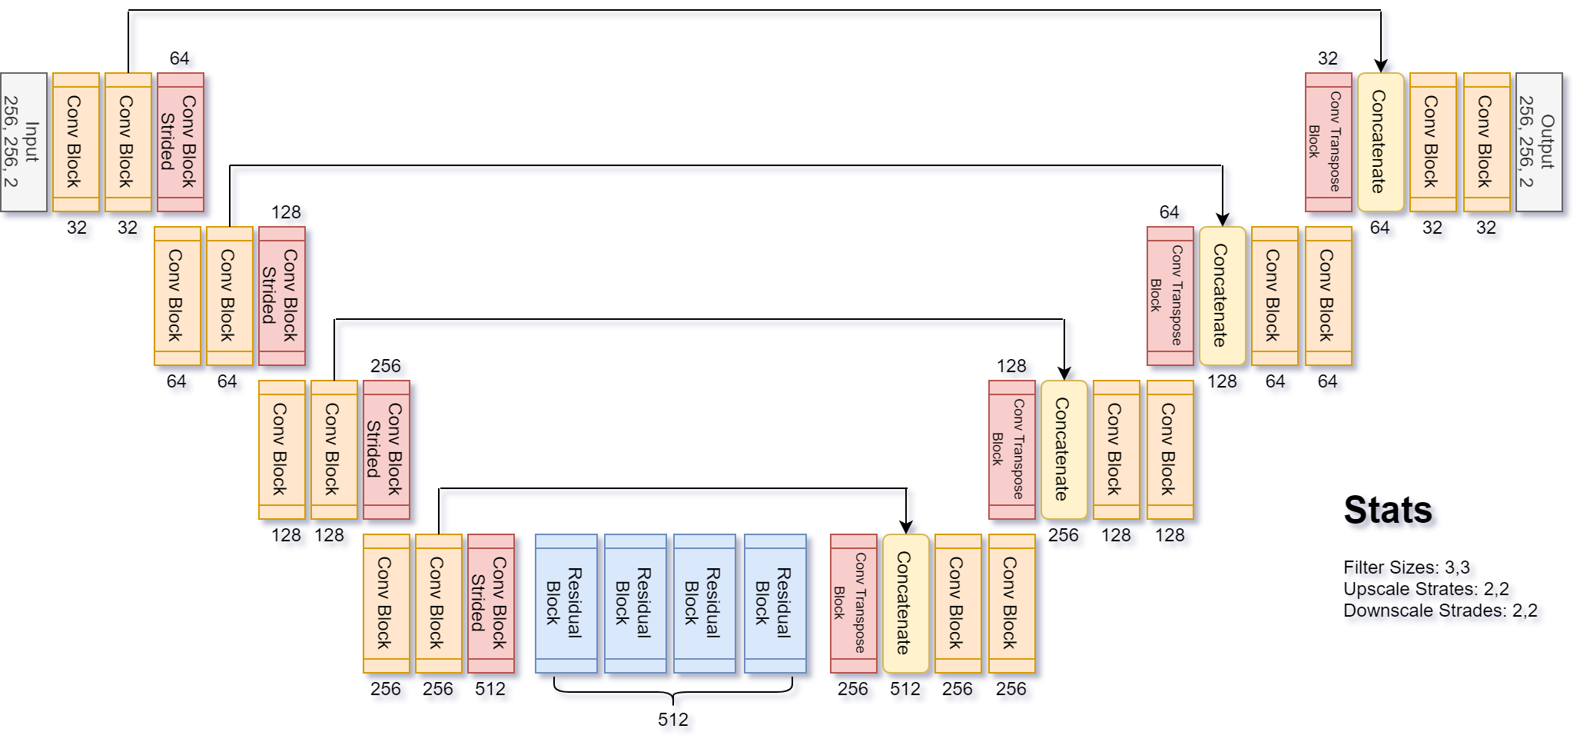
Base Model (DumbellXL) Architecture

Slide 9
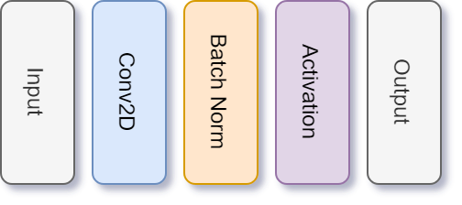
Convolutional Block (Strided)

Slide 10
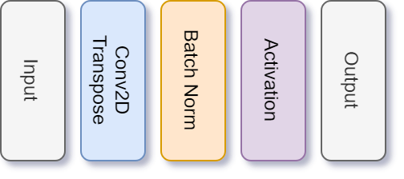
Convolutional Transpose Block

Slide 11
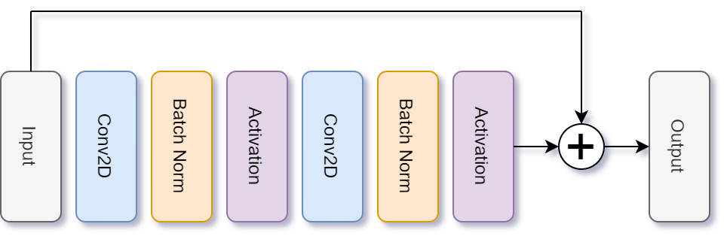
Residual Block

Slide 12
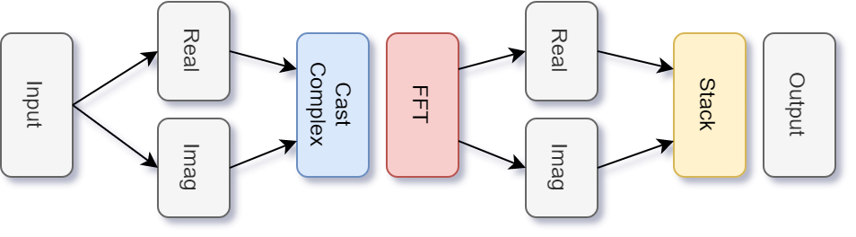
FFT Block

Slide 13
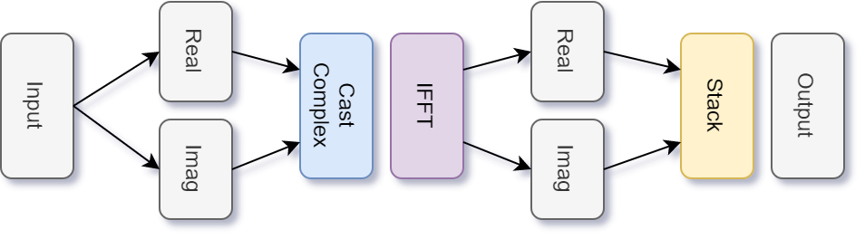
IFFT Block

Slide 14
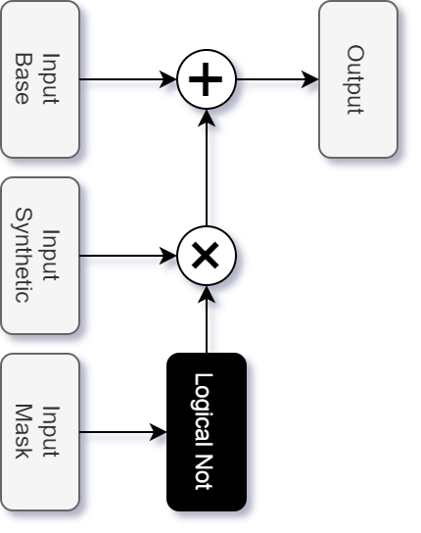
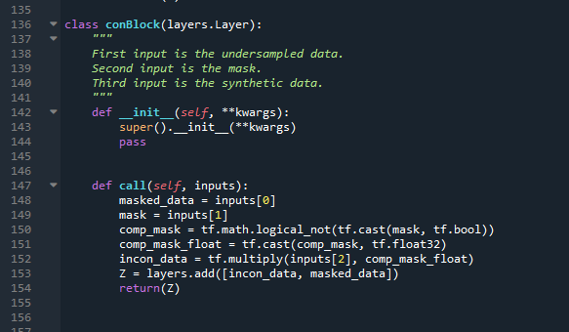
Consistency Block

Slide 15
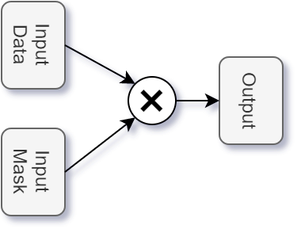
Undersample Block

Slide 16
Common Model Parameters
Optimizer: Adam
Learning Rate: 1e-3
Training: 20 epochs
Parameters:
DumbellXL: 16.5m (2x 33.0m, 3x 49.5m)
DumbellXL v4: 22.8m (2x 45.6m)
U-Net: 31m (2x 62m)

Slide 17
Statistical Results

Slide 18
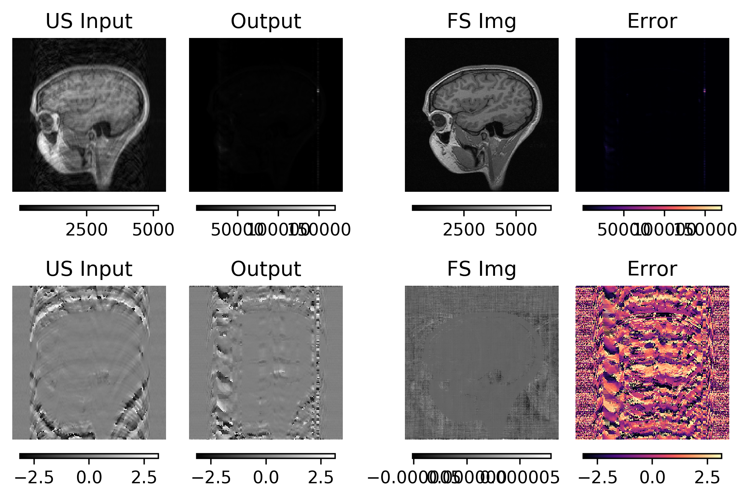
PSNR Results

Slide 19
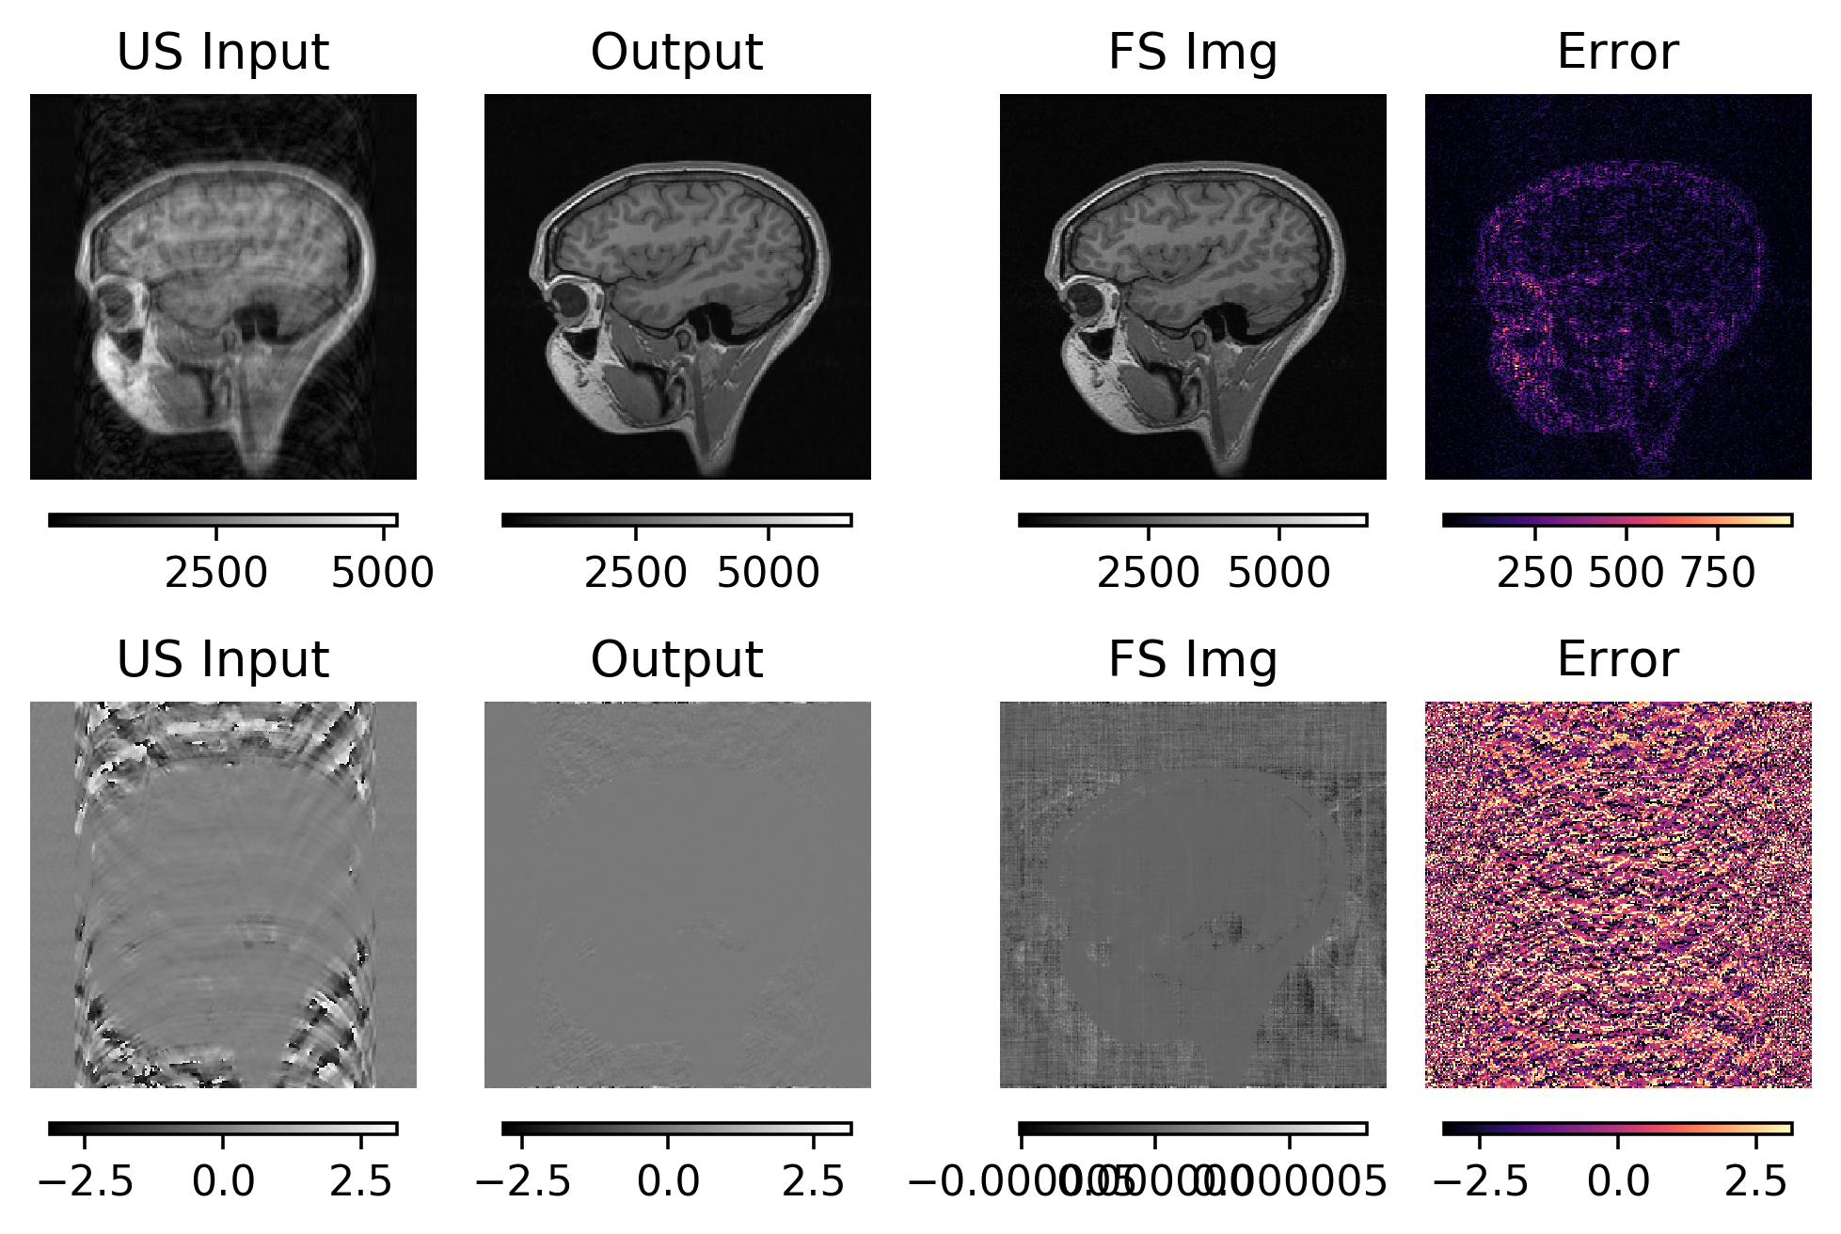
DumbellXL 3x MSE

Slide 20
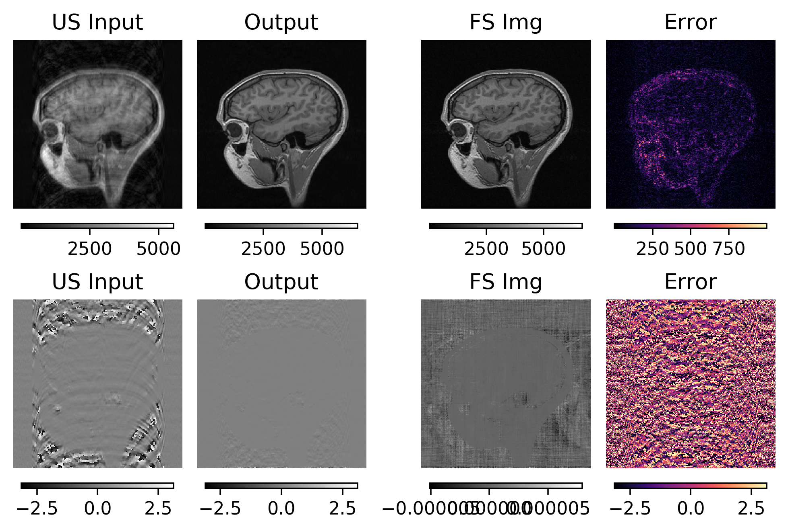
DumbellXL 2x v4 MSE

Slide 21
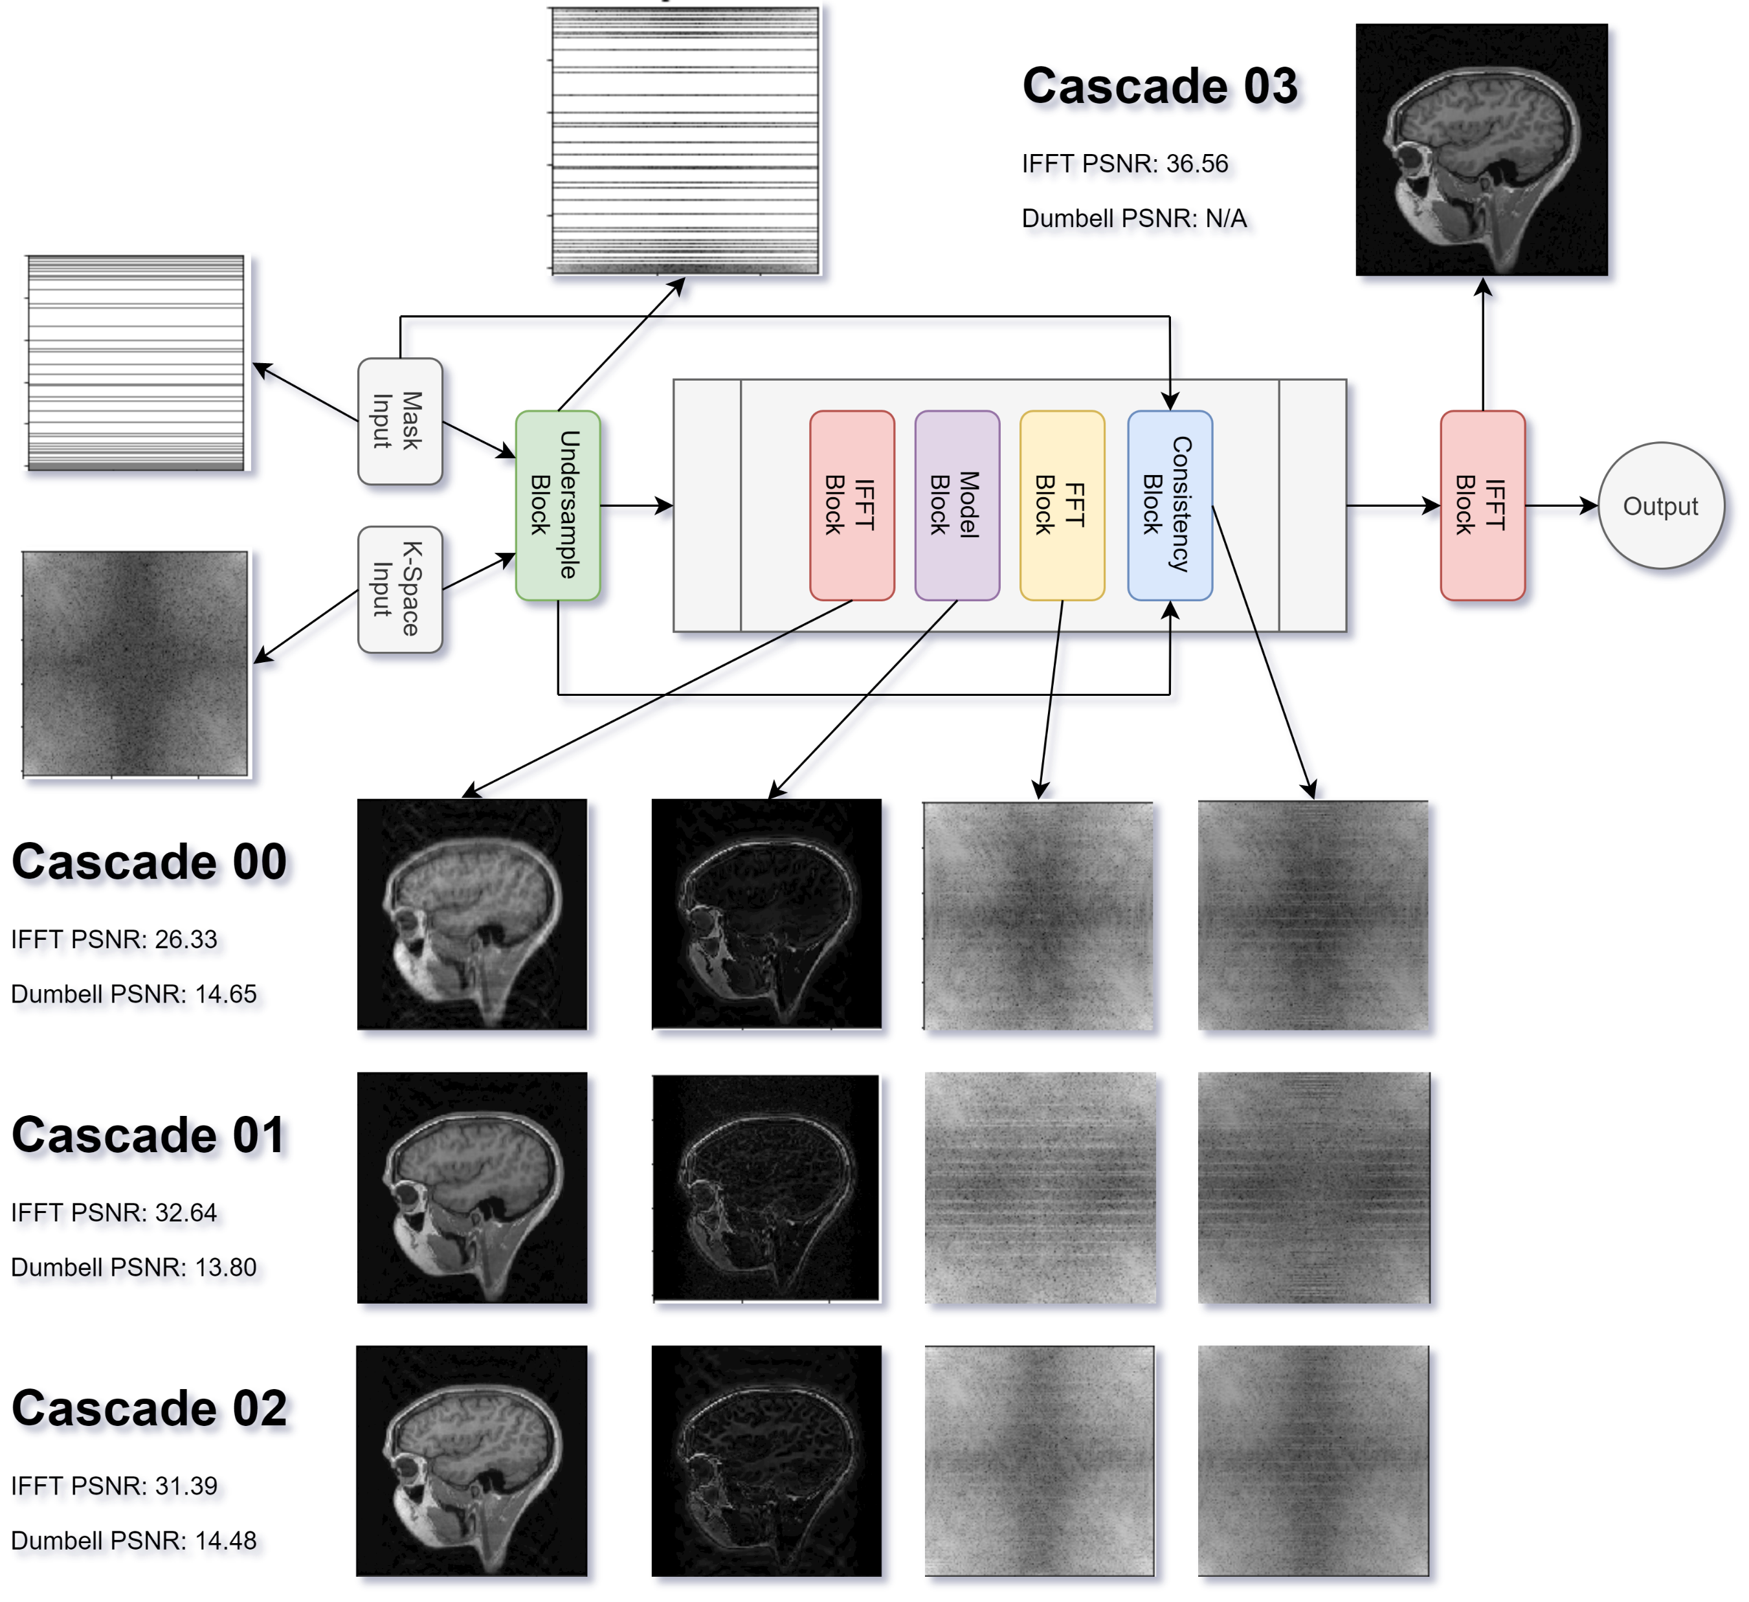
Intermediate Activations

Slide 22
Conclusions
More cascades are better.
DumbellXL v4 can perform better but it has more parameters. Thus DumbellXL v1 can be used with more cascades.

